Slide 1
Smart wardrobe
D23124670 Pavan Kumar Murugan
D23124872 Muhammad Osama Noor Uddin
D23127255 Jiaxin Zhang
D23125391 Lin Chen
D23124871 Salil Sunil Luley

Slide 2
Introduction
Goal: To develop a cutting-edge, AI-powered fashion platform offering personalized and seamless shopping experiences.
Key Features:
Natural Language Search
Users can search for products with natural queries like "Show me eco-friendly, sleeveless jumpsuits for a summer festival under 75 euros, with reviews mentioning comfort and durability." or by uploading images for visual search.
Personalized Recommendations
Content-Based Filtering: Recommends products based on features (color, style, brand).
Collaborative Filtering: Suggests items based on similar user preferences.
Outfit Matching
AI suggests complementary items to complete an outfit, enhancing user experience and boosting sales.
Sentiment Analysis
Automatically generated review summaries like “Highly rated for comfort” to provide quick, insightful feedback for users.
Benefits:
Personalized shopping experience
Faster and more intuitive product search
Increased customer satisfaction

Slide 3
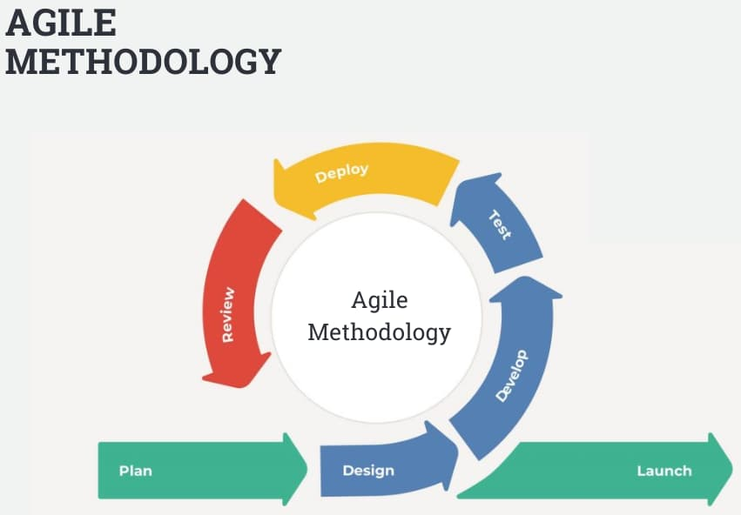
Software Methodology
Agile Methodology.
We will organize a 15-minute stand-up meeting every morning.
Development Management and Progress Tracking – Jira.
Code review before merge.
Code Management: GitHub.

Slide 4
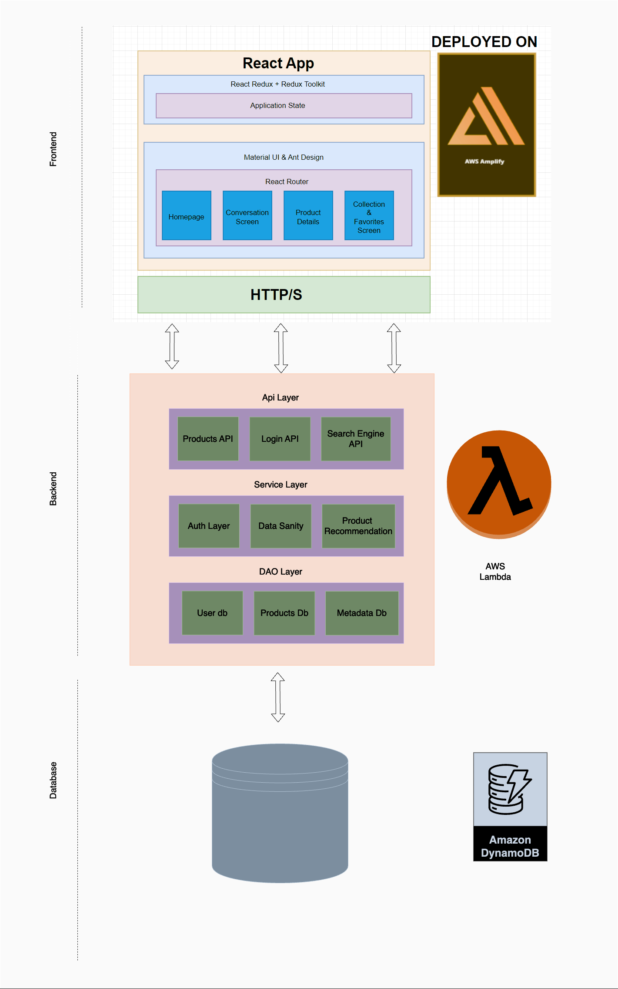
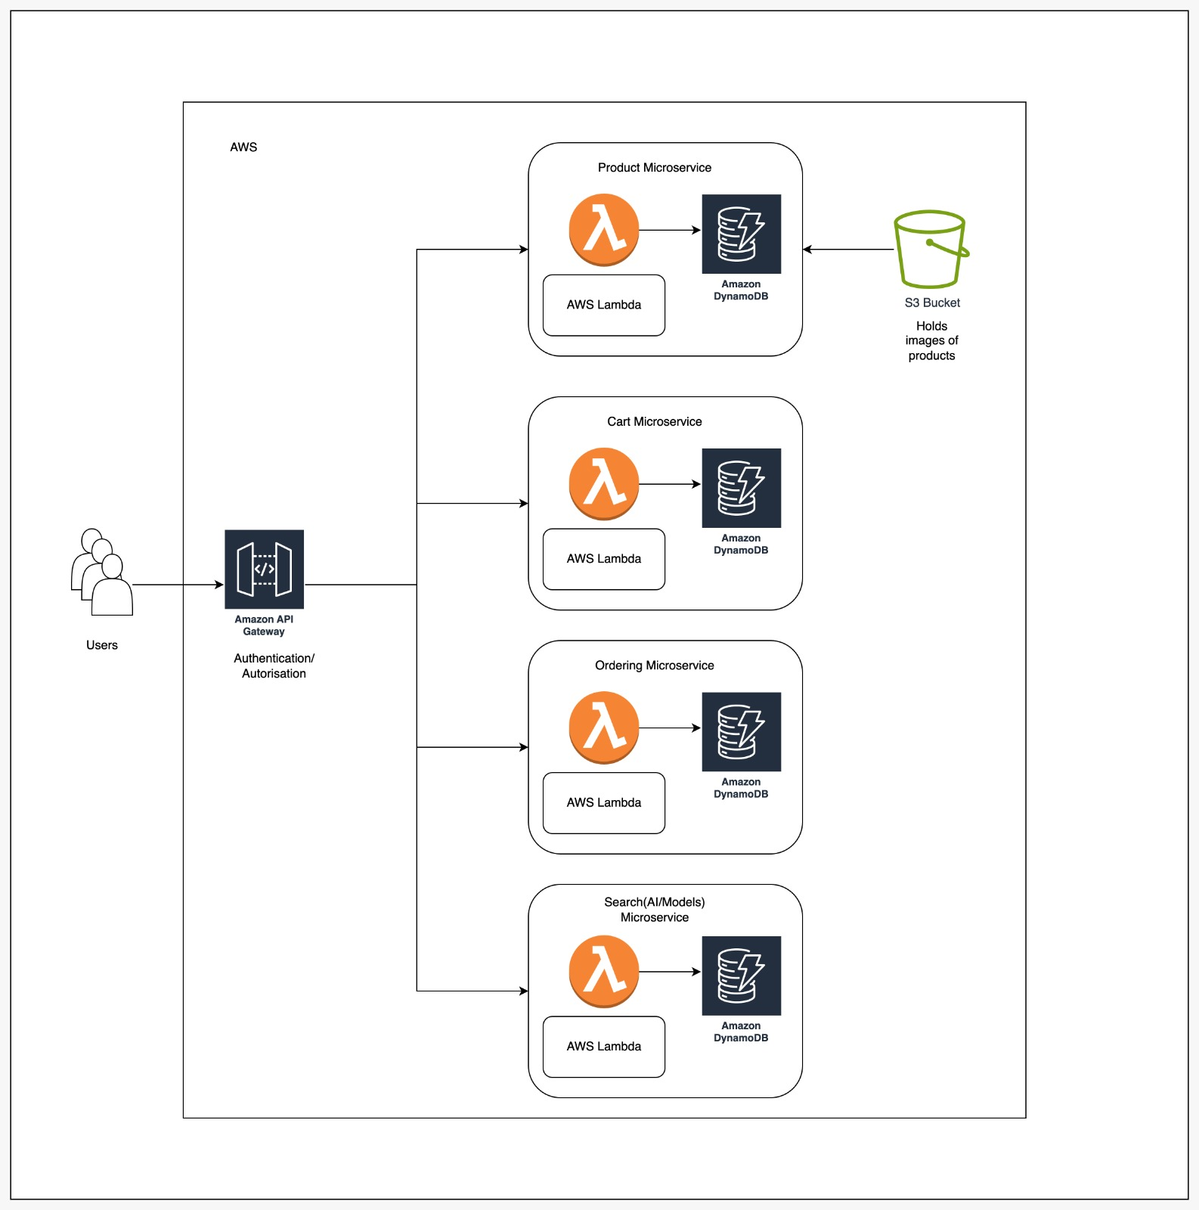
Technical Architecture
Technology Stack
Node JS
AWS Lambda
AWS Amplify
Amazon DynamoDB
Amazon S3

Slide 5
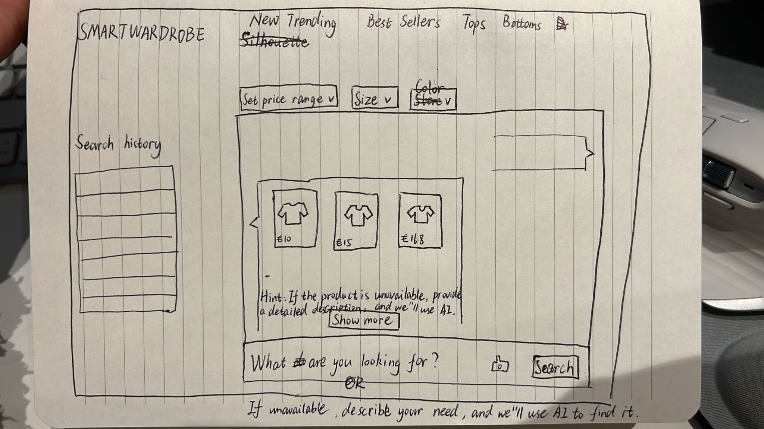
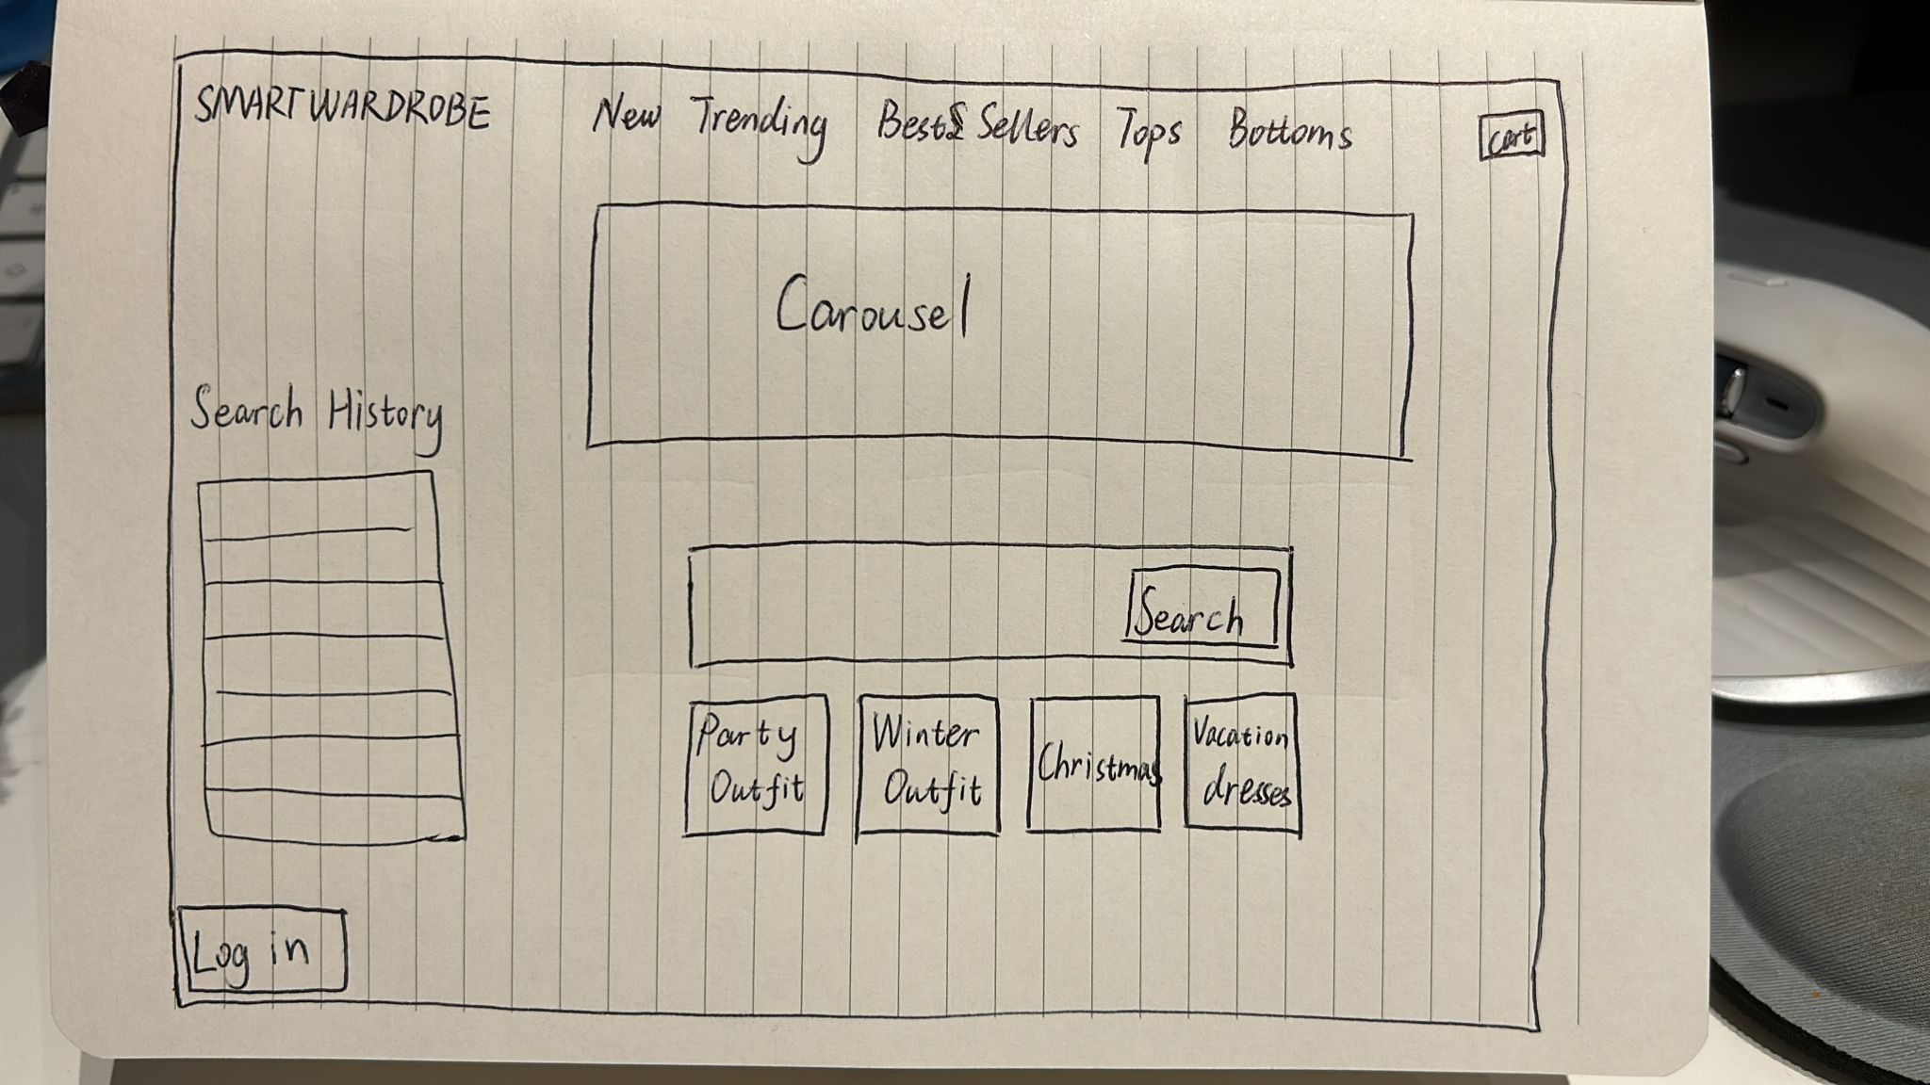
Low Fidelity design
Interactive search
Main Page

Slide 6
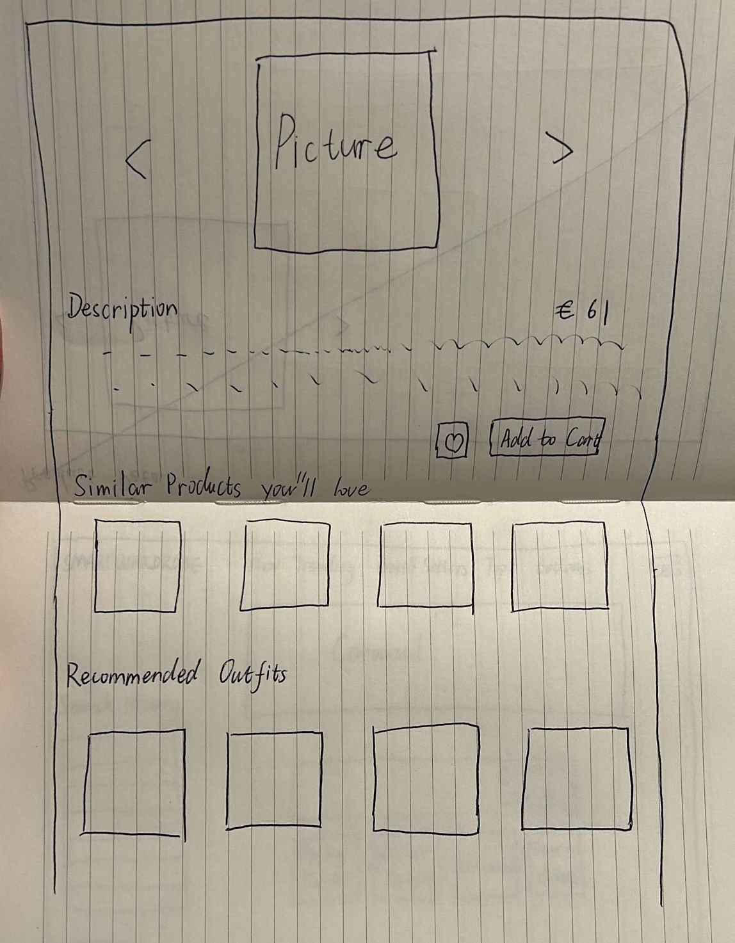
Low Fidelity design
Product Detail and Recommendations

Slide 7
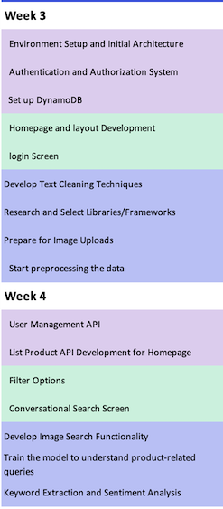
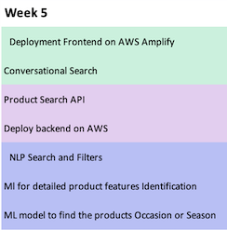
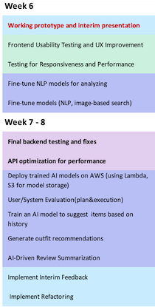
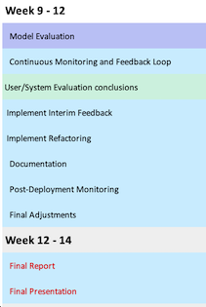
Milestones

Slide 8
Evaluation considerations
Front-end Evaluation
Iterative improvements based on feedback.
Wireframe design before development for consistency.
Test React components separately.
Validate UI performance across browsers & devices.
Back-end Evaluation
Test API endpoints for reliability & security.
Ensure service integration is seamless.
Simulate high-traffic to test system capacity.
Measure response times, focusing on AI-powered features.
Data and Model Evaluation
Clean, deduplicate, and process missing data.
Ensure data accuracy and timeliness.
Evaluate NLP accuracy, sentiment analysis, and recommendation performance.
Use user feedback to retrain and improve model performance.

Slide 9
user groups
Fashion Enthusiasts: Users who follow the latest fashion trends and are always looking for new, stylish outfits.
Casual Shoppers: Users who occasionally shop for clothing and accessories but don't spend significant time on fashion.
Deal Seekers: Users focused on finding the best deals and discounts on fashion items.
Frequent Online Shoppers: Users who shop online frequently, seeking convenience and a personalized shopping experience.
Stylists & Influencers: Fashion experts and content creators who curate outfits and trends for their followers.
Gift Shoppers: Users looking to purchase fashion items as gifts for others.
Eco-conscious Shoppers: Users focused on sustainability and ethical fashion.
Age Groups:
Teens (13-18 years): Social media influence, focus on brand awareness, and visual appeal.
Young Adults (19-25 years): High online shopping activity, influenced by influencers, and seeking personalized recommendations.
Adults (26-35 years): Looking for versatile pieces, often shopping for both work and casual wear.
Middle-Aged Adults (36-50 years): Prioritizes quality over quantity, seeking reliable brands, and occasionally shopping for family members.
Older Adults (50+ years): More selective shopping, value-driven purchases.

Slide 10
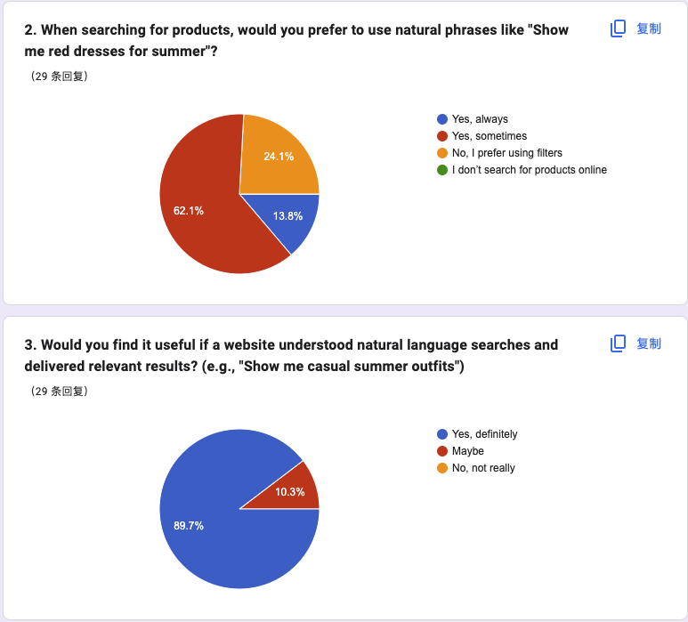
sUrvey
Natural language search is needed.

Slide 11
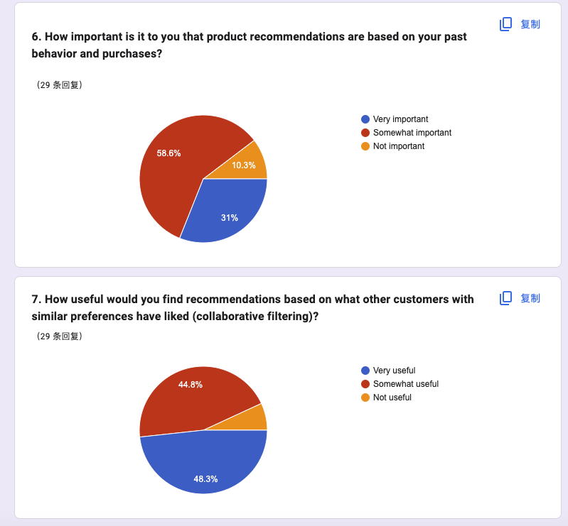
sUrvey
Recommendation system is needed.

Slide 12
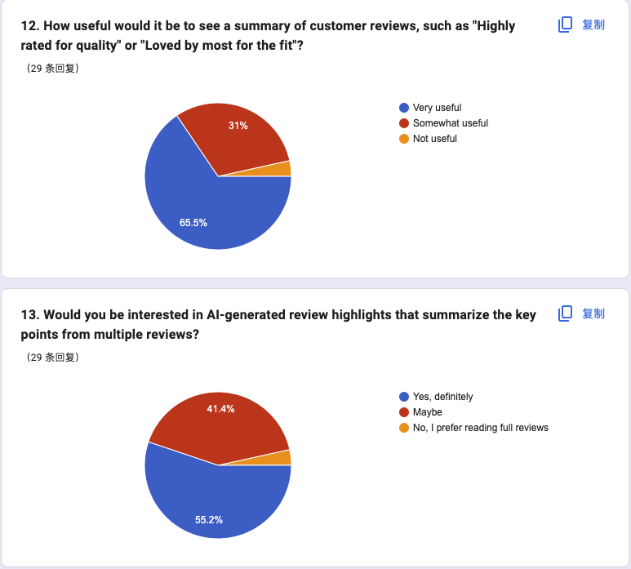
sUrvey
A summary of reviews is needed.

Slide 13
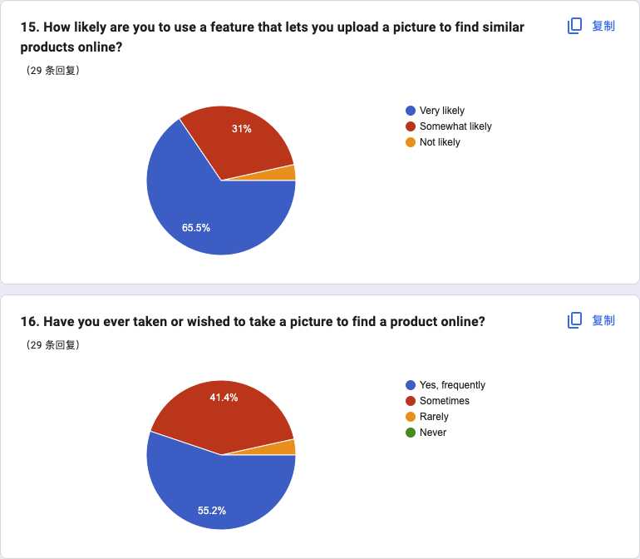
sUrvey
Picture searching is needed.

Slide 14
Any Question?

